Slide 1



Mobile Safety Application Development
This presentation outlines the development of a mobile safety application designed to enhance personal security through the integration of advanced technologies. The application aims to provide a reliable and user-friendly platform for vulnerable individuals, particularly the elderly, to quickly and effectively send distress signals, share their location, and record audio when needed.
by Eric Niee

Slide 2
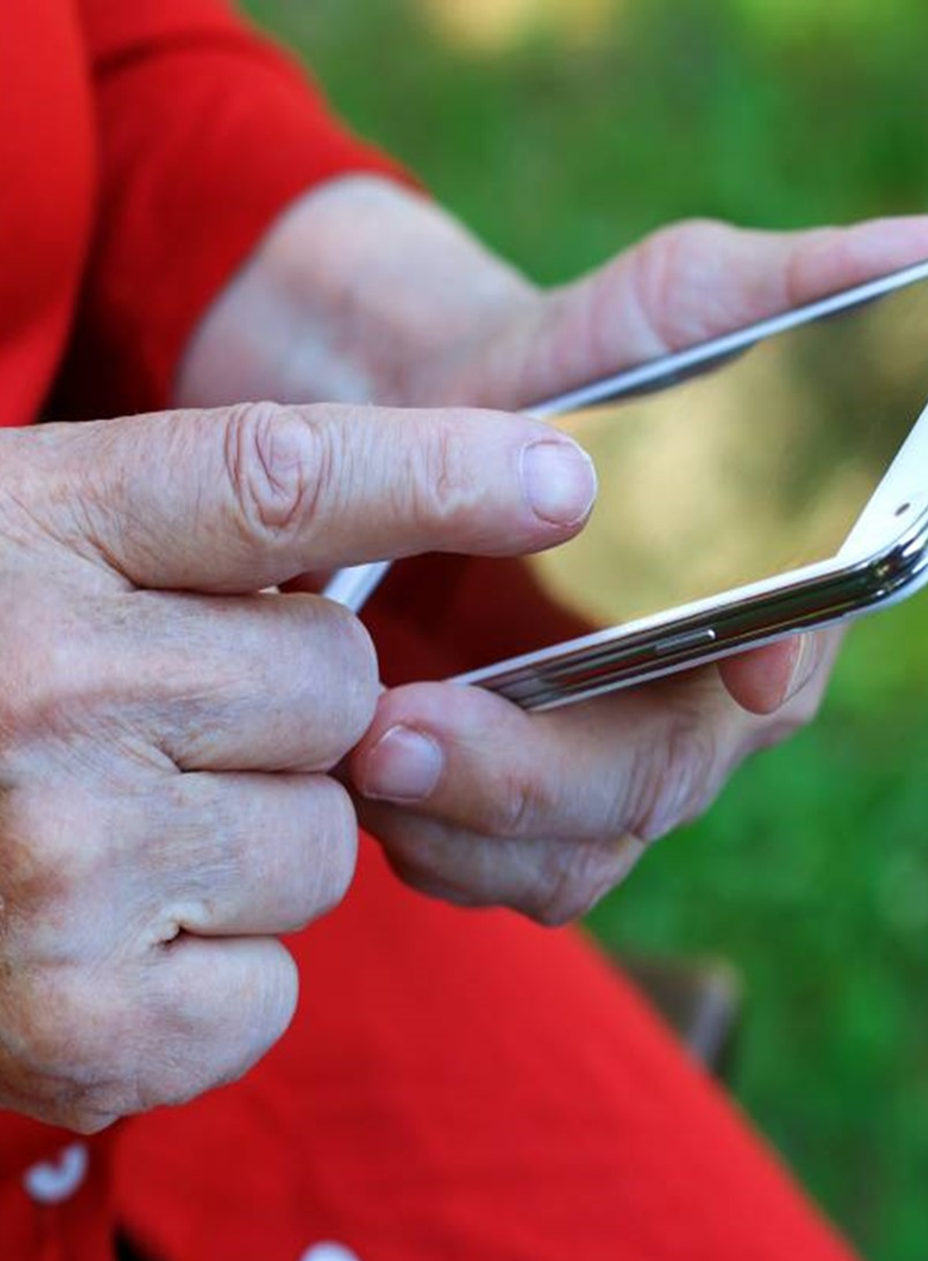
Project Objectives
The primary goals of this mobile safety application project were to develop a comprehensive solution that empowers users, especially those in vulnerable populations, to enhance their personal security. Key objectives included integrating real-time location tracking, implementing robust SOS functionalities, and designing a user-friendly interface tailored for critical situations. By leveraging cutting-edge technologies, such as GPS, IoT connectivity, and secure messaging protocols, creating a mobile application that could provide immediate assistance and peace of mind for those who may require it most.
Enhance Personal Security
Deliver User-Friendly Experience
The application was designed to empower vulnerable users by providing them with a reliable tool to quickly and effectively send distress signals, share their location, and record audio when needed.
A key focus of the development process was to design a mobile application with a clean, intuitive user interface that would be easy to navigate and use, even under stressful conditions.
1
2
3
Integrate Advanced Technologies
The project incorporated cutting-edge technologies, including GPS tracking, IoT connectivity through the ESP8266 module, and secure MQTT messaging protocols, to ensure the application's effectiveness and responsiveness in emergency situations.

Slide 3

System Design and Architecture
The mobile safety application's system design and architecture were carefully crafted to ensure a robust and reliable platform for emergency communication. The application integrates several key components, including the Android device (or Simulator), the ESP8266 Wi-Fi module, and the MQTT messaging protocol, to create a comprehensive solution that addresses the needs of vulnerable users.
Android Device
ESP8266 Wi-Fi Module
MQTT Messaging Protocol
The mobile application is developed for the Android platform, leveraging the device's built-in GPS and sensor capabilities to track the user's location and enable audio recording functionalities.
The ESP8266 Wi-Fi module is integrated into the system architecture, providing the necessary connectivity to receive distress alerts on monitor and location data to the MQTT cloud service broker.
The application utilizes the MQTT protocol for efficient and reliable messaging between the mobile device and the cloud/server, ensuring prompt delivery of emergency alerts and location updates.

Slide 4
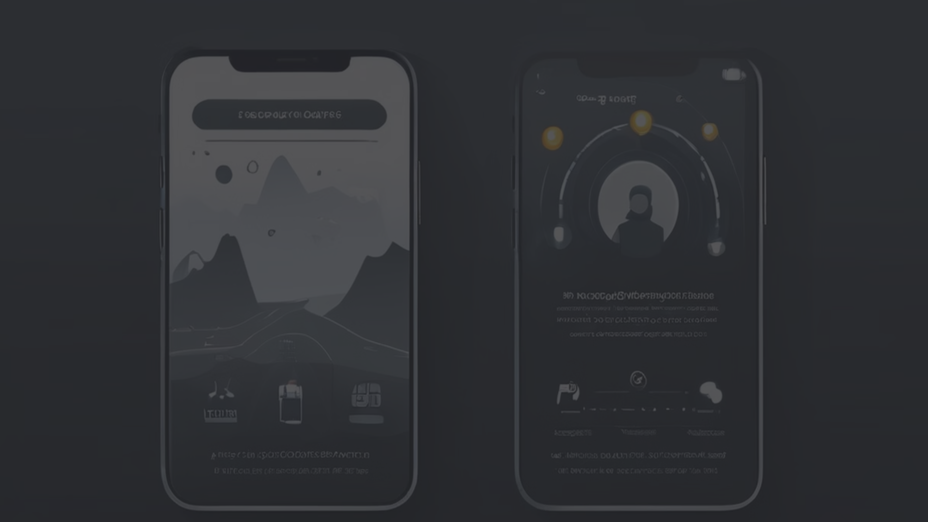
Key Features and Functionalities
The mobile safety application offers a comprehensive set of features designed to enhance the personal security of its users, particularly the vulnerable community. These features include real-time location tracking, emergency SOS functionality, and audio recording capabilities, all seamlessly integrated to provide a reliable and user-friendly experience.
1
Real-Time Location Tracking
2
Emergency SOS Functionality
3
Audio Recording Capabilities
The application utilizes the device's GPS and Wi-Fi capabilities to provide accurate and up-to-date location information, which can be instantly shared with emergency services and trusted contacts in the event of a crisis.
With a simple press of a dedicated SOS button, the application can instantly sound an audible siren, activate an emergency alert, notifying emergency responders and pre-selected contacts of the user's location and need for assistance.
The application integrates audio recording functionality, allowing users to capture crucial audio clips that can be used as evidence or to provide additional context to emergency responders during a crisis.

Slide 5




User Interface and Interaction
The mobile safety application's user interface has been meticulously designed to ensure a seamless and intuitive experience, particularly during emergency situations. The team has prioritized simplicity, clarity, and accessibility to empower users, even those with limited technical expertise, to quickly and effectively utilize the application's critical features.
Location Tracking
SOS Button
Audio Recording
Emergency Contacts
The user interface prominently displays the user's current location, providing a clear and easily accessible visual representation of their whereabouts.
The SOS button is designed with a distinct visual cue, such as a large, red button, to ensure it can be quickly and easily identified and activated in an emergency.
The audio recording functionality is accessible through a clearly labeled icon, allowing users to capture important audio evidence during a crisis.
Users can easily manage and update their emergency contacts, ensuring that critical information is readily available in the event of an emergency.

Slide 6
Testing and Evaluation
Rigorous testing and evaluation were essential components of the mobile safety application's development process. By conducting a comprehensive series of tests, including integration, system, and performance testing, to ensure the application's reliability, functionality, and user-friendliness.
Integration Testing
System Testing
Integration tests were carried out to evaluate the performance of the application's interconnected modules, such as the user interface, backend services, and hardware integrations like the ESP8266 and GPS sensors. This phase helped identify and resolve any issues related to data flow and module interactions.
System testing examined the application as a whole, verifying that it met the defined specifications and requirements. This phase involved creating complex scenarios to test the system's response and stability under simulated real-world conditions, ensuring the application's overall functionality and reliability.
Performance Testing
Security and Reliability
Performance testing was a crucial aspect of the system testing, evaluating the application's responsiveness and stability under varying levels of load, such as handling multiple simultaneous SOS signals. This ensured the application remained reliable and responsive, even during peak usage.
Security testing was conducted to safeguard user data and ensure the application's overall security, while reliability testing checked the application's ability to perform consistently over an extended period, identifying any potential durability or consistency issues.

Slide 7

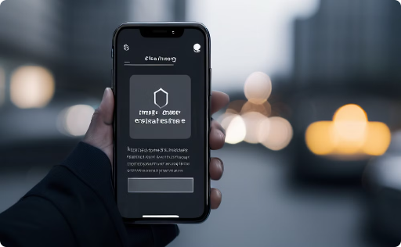
User Acceptance Testing and Feedback
The mobile safety application underwent extensive User Acceptance Testing (UAT), involving real-world users, particularly family members, to gather valuable feedback and insights. The testing process provided crucial information to refine the application's usability and security features, ensuring it meets the needs of the target audience.
Usability Feedback
Security Evaluation
The feedback received during the UAT was largely positive, with testers praising the application's user-friendly interface and the straightforward mechanism for activating the SOS feature, which was deemed critical in emergency situations. However, areas for improvement were identified, such as the need for more distinct visual cues for the active states of emergency features.
Security testing confirmed the effectiveness of the application's current security measures, but feedback from family members highlighted the need for more intuitive privacy settings. Testers expressed a desire for clearer controls to manage their personal information, prompting plans to refine the user interface and conduct an in-depth review of the existing encryption methods.

Slide 8
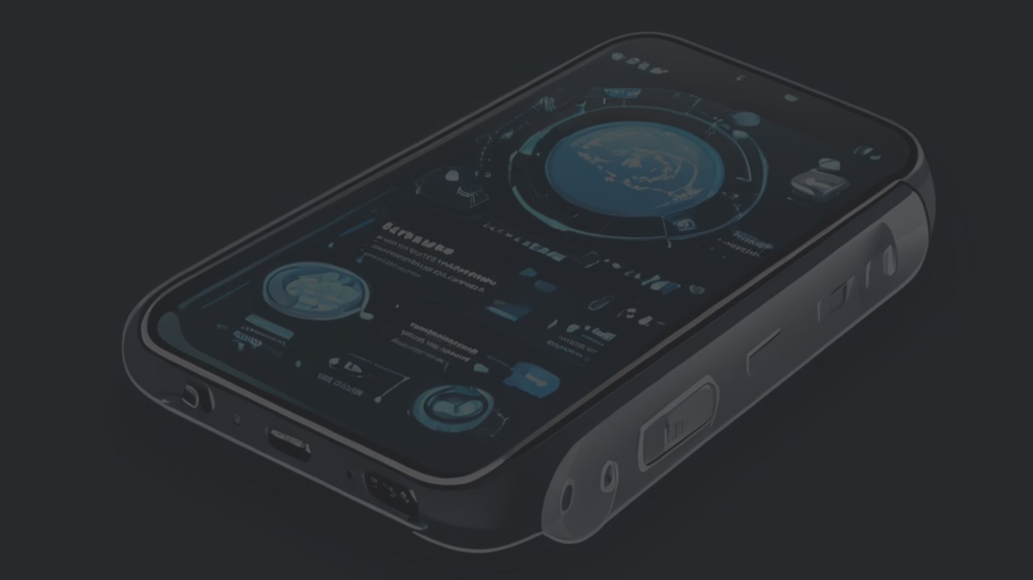



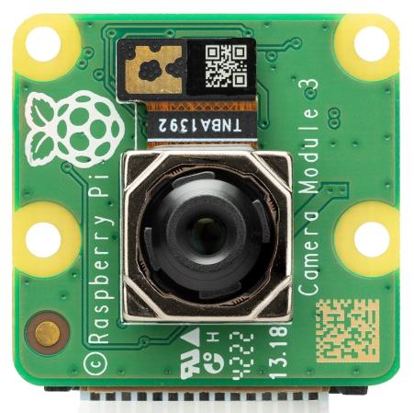
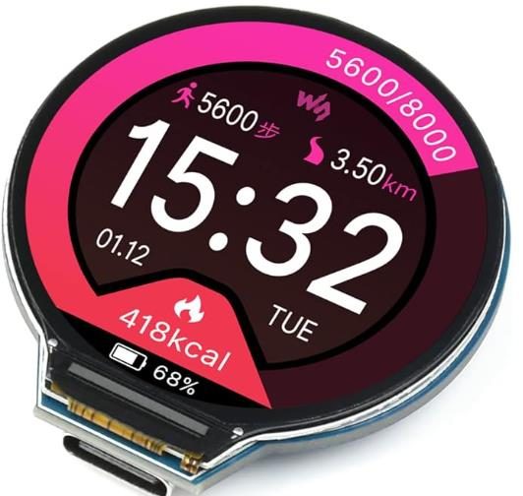
Future Enhancements and Recommendations
To further enhance the mobile safety application and ensure its continued relevance and effectiveness, several key recommendations have been identified for future development. These enhancements aim to expand the application's capabilities, improve user experience, and address evolving security concerns.
Camera Integration
Wearable Integration
Room Monitoring
Integrating live video streaming capabilities could significantly enrich the application's emergency response features by providing real-time visual context to responders, helping them assess the situation more accurately and respond more effectively.
Expanding the application's functionality to connect with wearable technologies, such as smartwatches, could enable additional safety features like fall detection and health monitoring, further improving the application's ability to assist vulnerable users.
Incorporating room temperature and humidity monitoring could provide critical health and safety benefits, especially for the elderly, by alerting users or caregivers to potentially dangerous environmental conditions.

Slide 9

Conclusion
The development of this mobile safety application has successfully demonstrated the potential for innovative technology to enhance personal security, particularly for vulnerable populations such as the elderly. Through the integration of advanced features like real-time location tracking, emergency SOS functionality, and audio recording capabilities, the application provides a comprehensive solution to empower users and ensure their safety in critical situations.
The rigorous testing and evaluation process, including user acceptance testing, has validated the application's effectiveness and reliability, while also identifying areas for future improvement. Recommendations for enhancements, such as camera integration, wearable connectivity, and environmental monitoring, aim to further expand the application's capabilities and ensure its continued relevance in addressing the evolving needs of its target audience.
By leveraging cutting-edge technologies and prioritizing user-centered design, this mobile safety application project has laid a strong foundation for the development of innovative personal security solutions. As technology continues to advance, the team remains committed to iterating on this application, incorporating new features and addressing emerging security challenges to maintain its position as a vital tool in enhancing the safety and well-being of vulnerable individuals.

